Slide 1


Enhancing accessibility of Biodiversity Data in Malawi through Partnerships and Information Management Tools
BIMF-FBIP Forum
20 August 2019
Donald Benito Mpalika
National Herbarium & Botanic Gardens Of Malawi

Slide 2
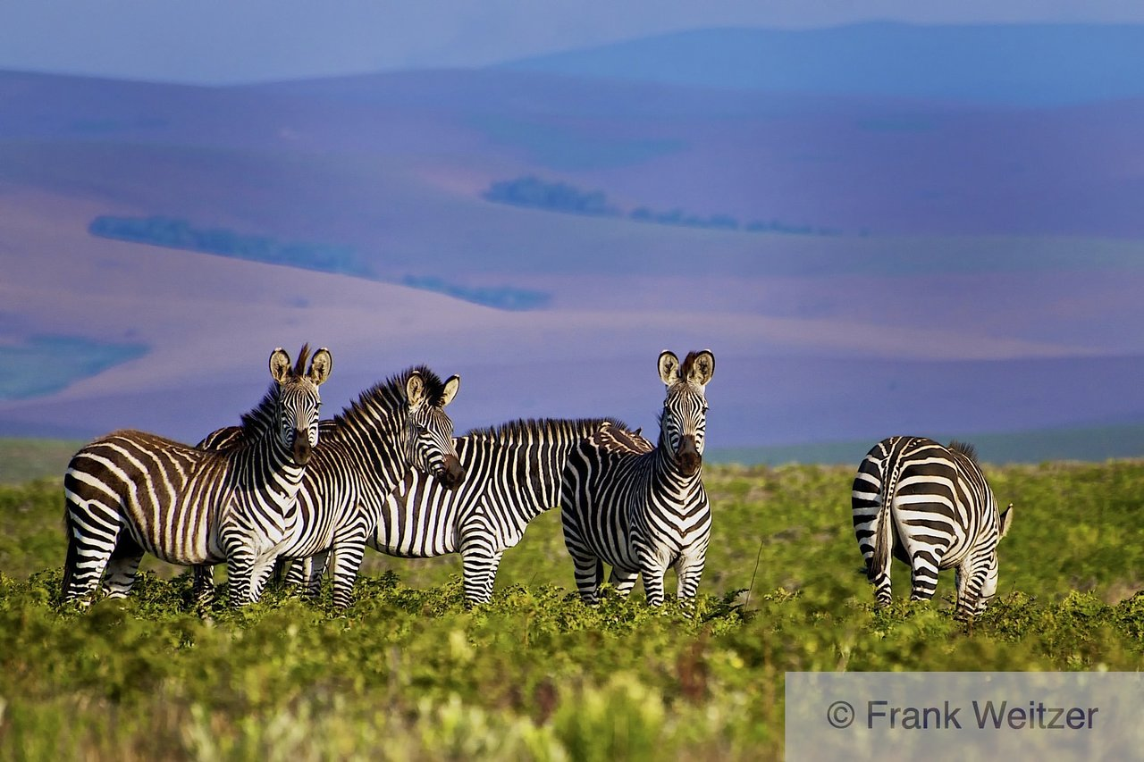
Natural habitats are under threat
Degradation and conversion
Climate Change
Invasive alien species
Over exploitation
Notes:
All these results in biodiversity loss

Slide 3
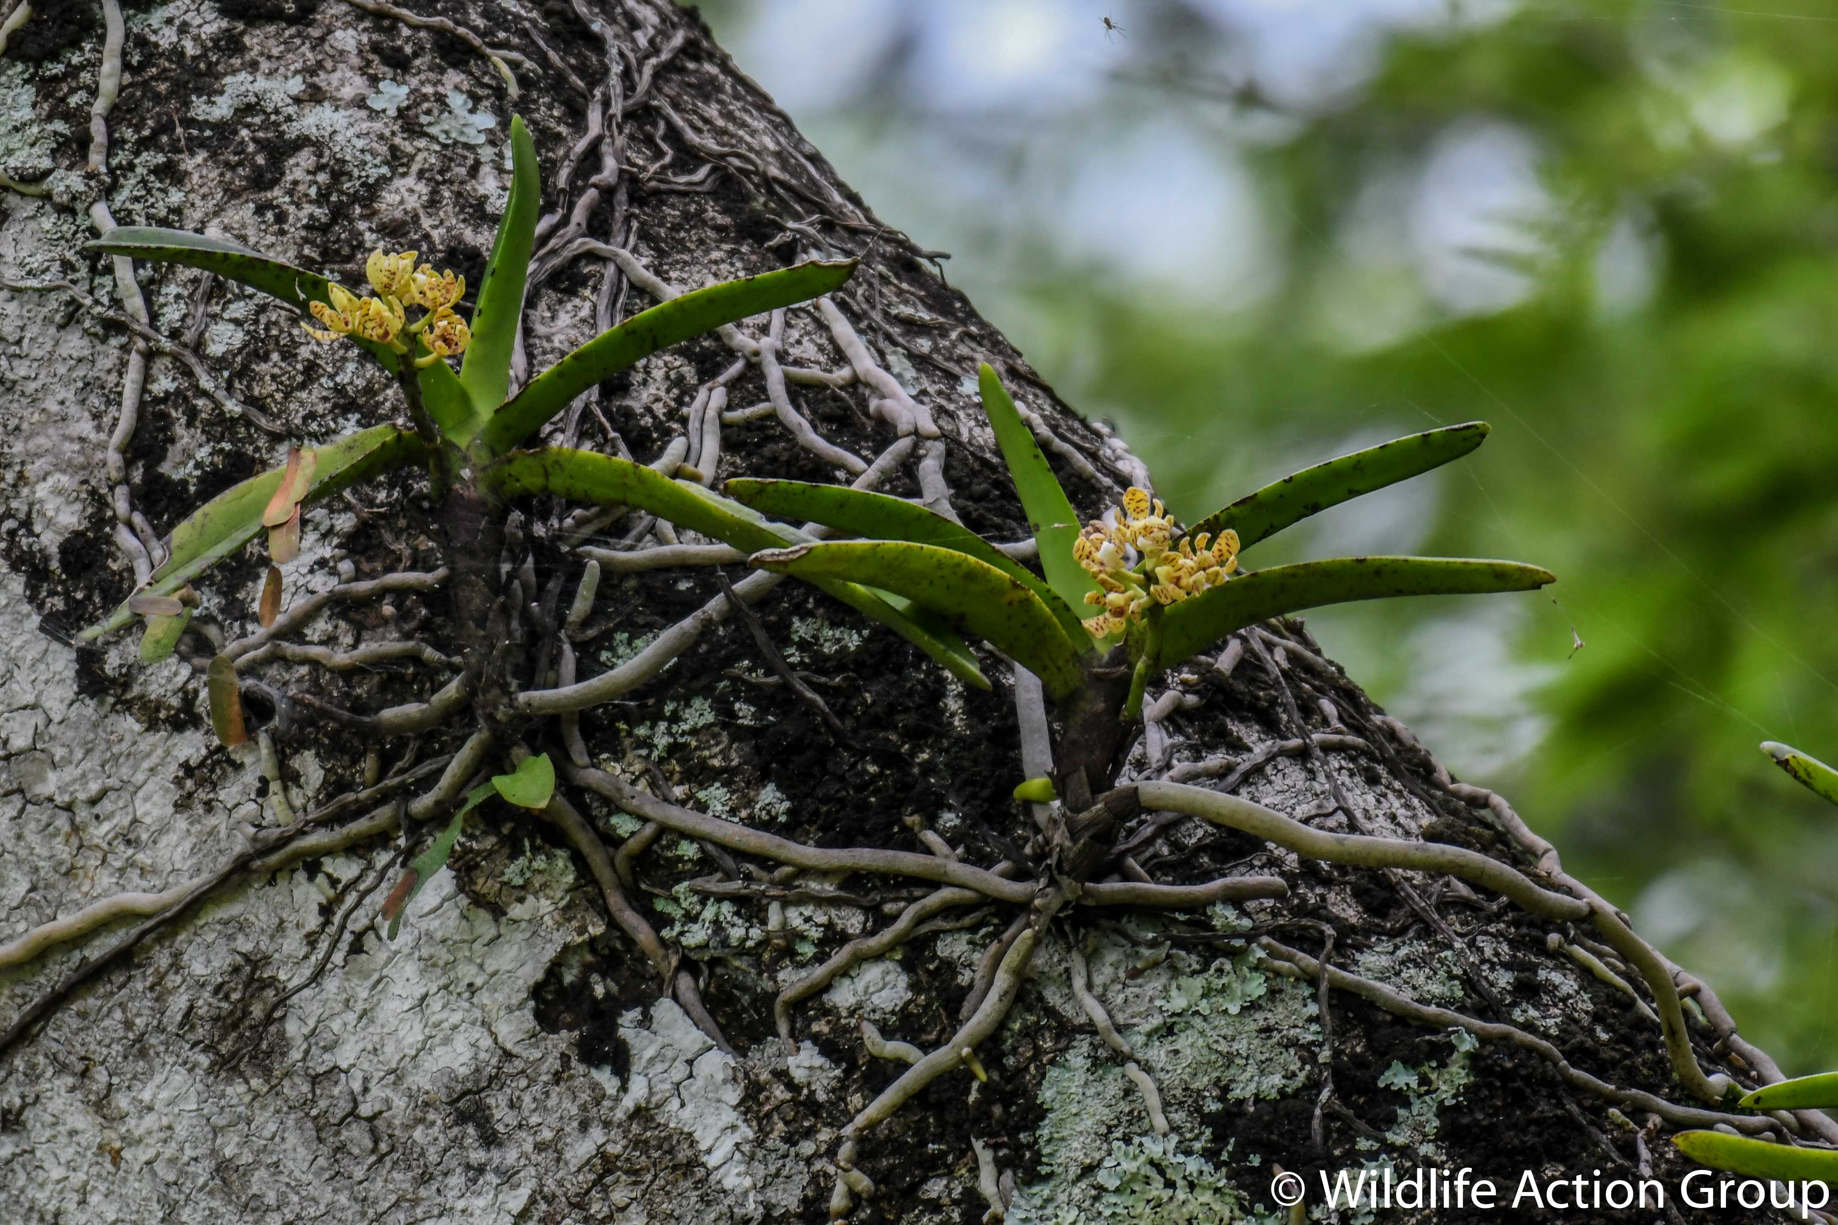
Biodiversity is not considered in;
National development plans
Land use management planning
Spatial development frameworks

Slide 4


Why biodiversity is not considered?
Potential policy relevant biodiversity data is not accessible to policy and decision makers

Slide 5

Breakthrough
.

Slide 6
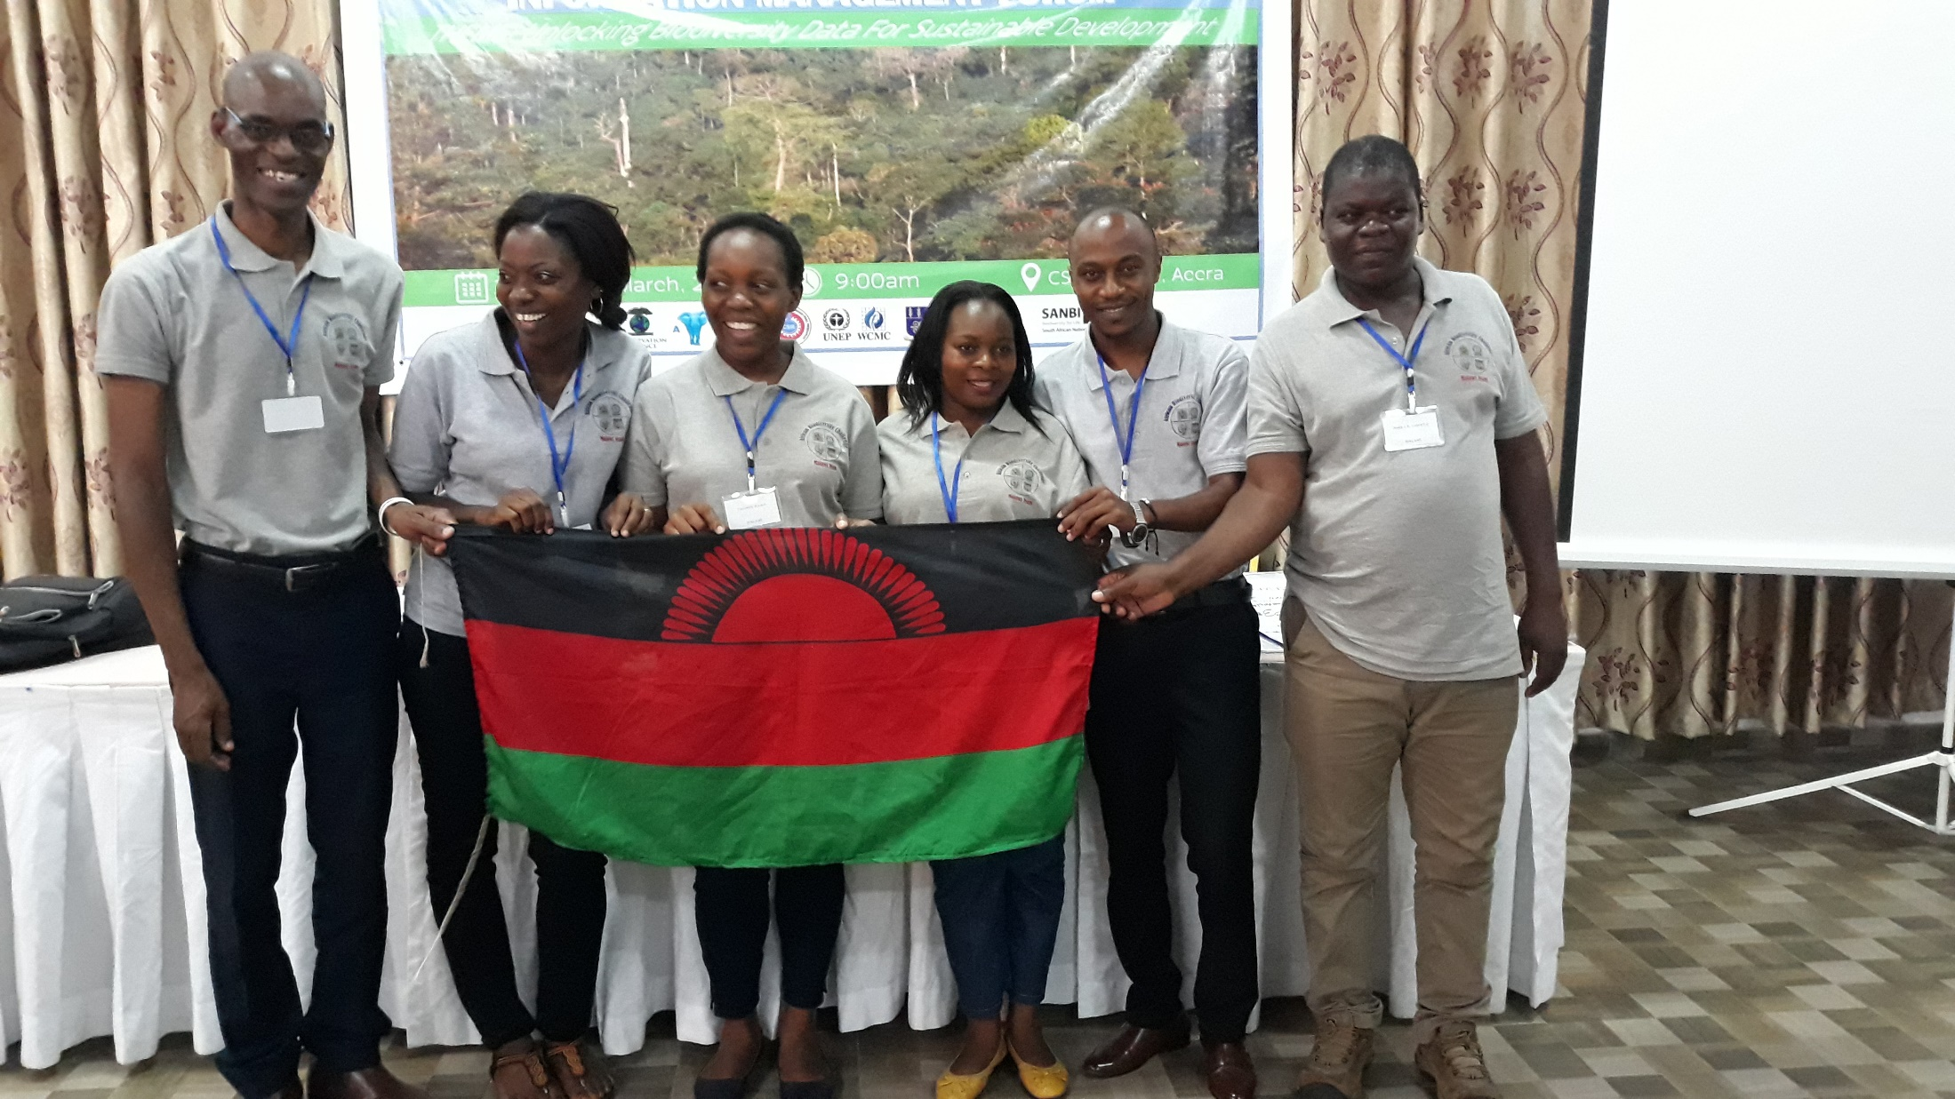


African Biodiversity Challenge Project

Slide 7
African Biodiversity Challenge Project
ABC Project coordinated by SANBI, is aimed at mobilising policy relevant biodiversity data in Malawi

Slide 8



Project Partners
Museums and Monuments (MaM)
National Herbarium and Botanic Gardens of Malawi (NHBG)
Wildlife and Environmental Society of Malawi (WESM)
National Commission for Science and Technology (NCST)

Slide 9
Building networks & Partnerships
Institutions that normally work independently came together
Notes:
Establish partnership with relevant stakeholders

Slide 10
Building networks & Partnerships
Increased collaboration with the Country GBIF Node (NCST)

Slide 11
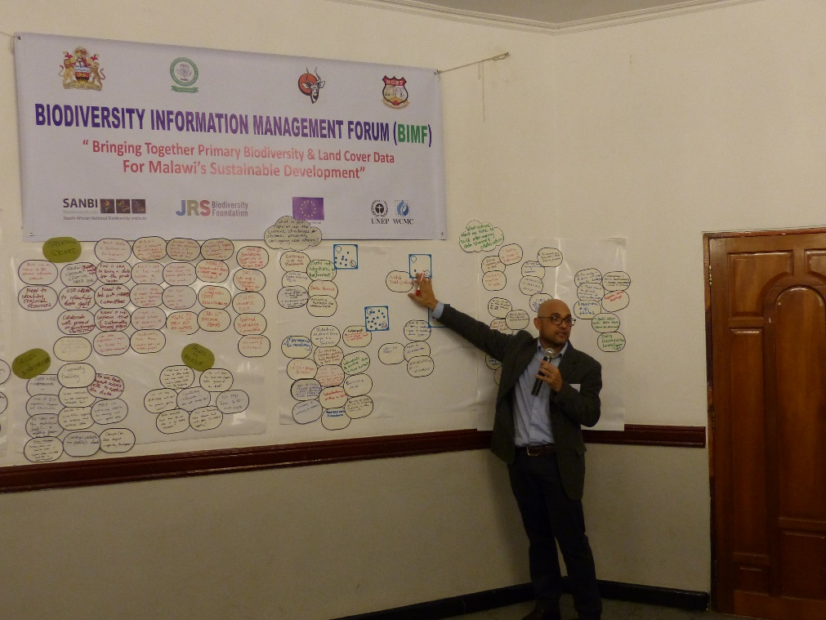
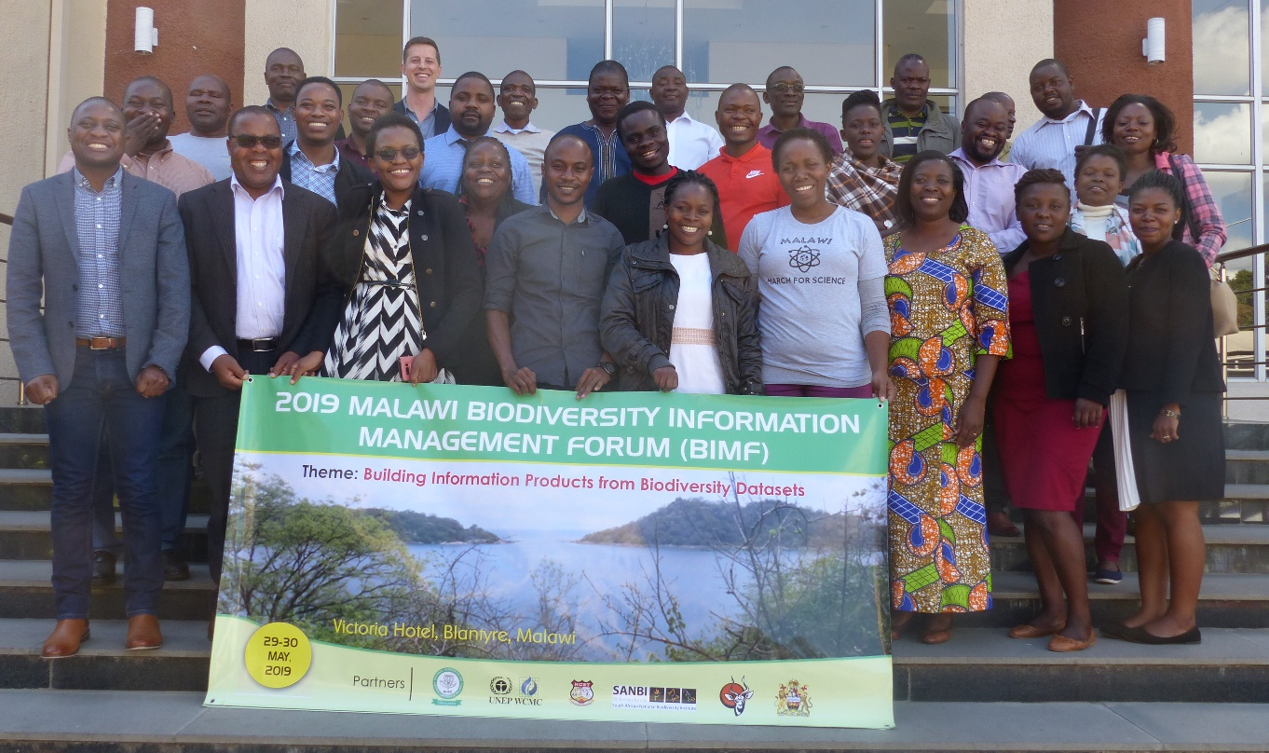
Building networks & Partnerships
First ever Biodiversity Information Management Forum

Slide 12
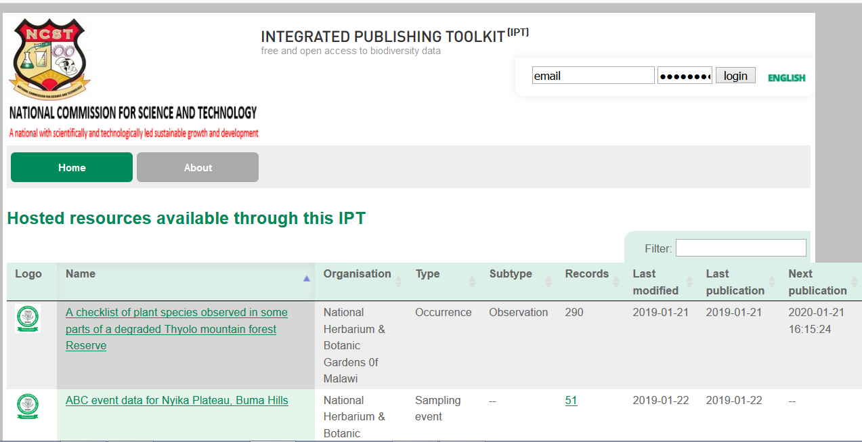
Setting up of IPT
A usable Biodiversity Integrated Publishing Tool

Slide 13
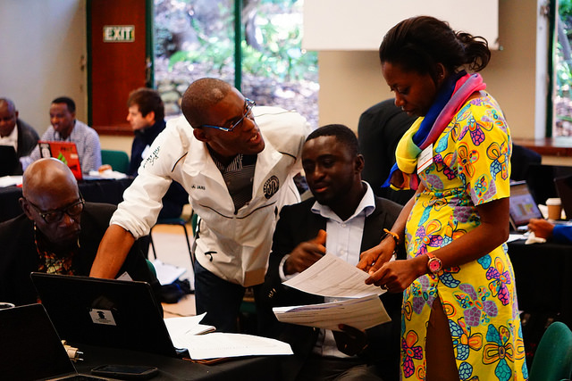
Increased capacity for Biodiversity Information Management
Project staff trained in biodiversity informatics

Slide 14
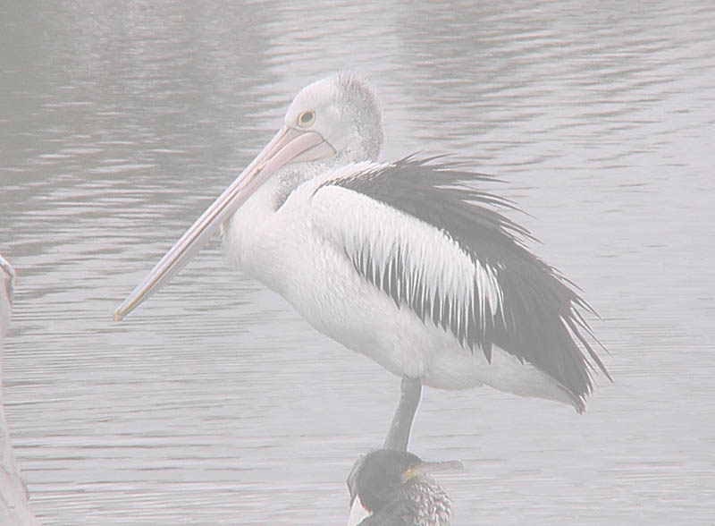

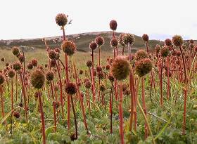
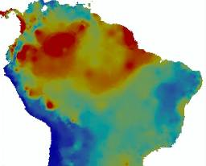
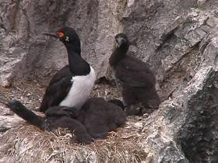
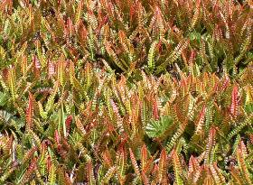
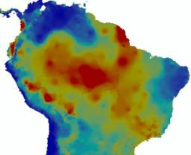
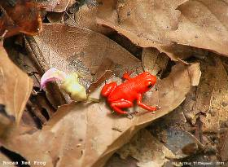

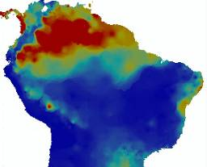
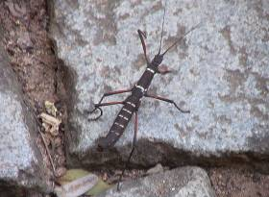
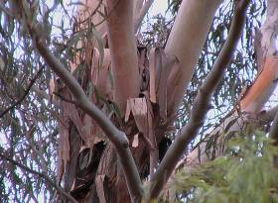
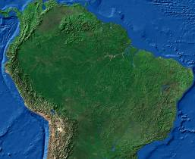
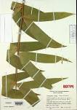
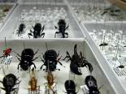


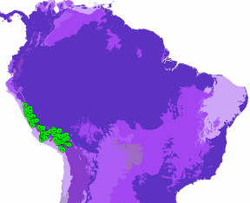
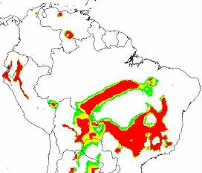
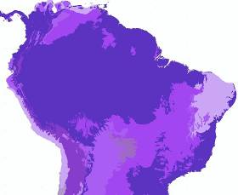
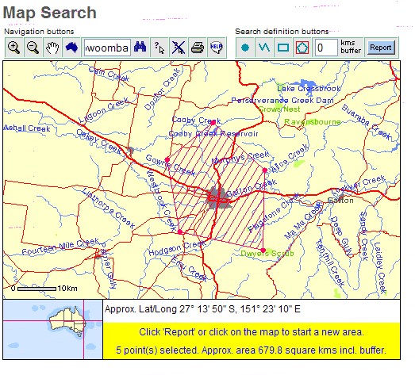
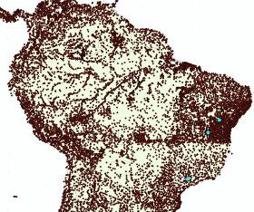
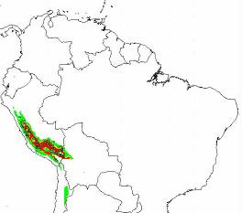
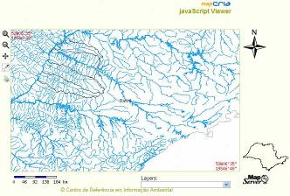
Taking data to information
Species Data
Species Data
Environmental Data
Information
Crab Florianopolis, Brazil
Armeria maritima Argentina
Temp Range
Rock Cormorants Argentina
Bocas Frog Panama
Fern - Tierra del Fuego
Rain June
Stick Insect Campinas, Brazil
Fungus Portugal
Rain Jan
Eucalyptus sp. California
Decisions
Policy
Conservation
Management
Models
GIS Data
Decision Support
Information
Notes:
What we as scientists and data managers are attempting to do is to take the vast amount of biodiversity data that exist in the world through the various stages of quality control and analysis (including combining with other data and information) to make them of value for environmental management, environmental policy making and the setting of conservation priorities, etc.

Slide 15
Thank you

