Slide 1

Bridging Taxonomic Gaps: Strategic Insights into Tick Species DNA Barcoding in South Africa N. Khumalo, M. Chaisi, R. Magoro, and M. Mwale

Slide 2
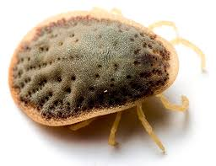
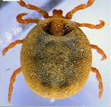
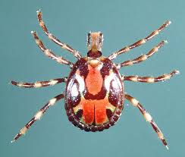
Introduction
Ticks are arthropods of medical and veterinary importance.
Ticks rank second only to mosquitoes as vectors of human infections, with wildlife serving as primary reservoir hosts for tick-borne pathogens.
Globally, approximately 970 tick species have been described, with majority belonging to the family Ixodidae (hard ticks)-771 species), Argasidae (soft ticks-193) and 1 monotypic species in the family Nuttalliedae.
Hard tick (Ixodidae)
Soft tick (Argasidae)
Nuttalliellidae

Slide 3
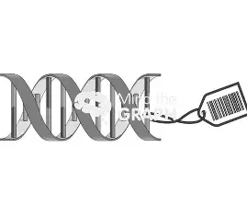
Introduction
Despite the extensive research on ticks in South Africa, knowledge gaps remain in tick taxonomy and diversity.
DNA barcoding through BOLD using mtDNA (COI), may help resolve uncertainties in tick taxonomy.
This method works by analysing specific genes.
Species-specific BINs are assigned when there are high interspecific differences but low intraspecific variation similar within a species.

Slide 4
Introduction
Although the BOLD reference database has grown significantly, with over 19 million specimen records published to date (https://www.boldsystems.org).
The global taxonomic coverage of published tick records notably vary among taxonomic groups and geographic regions due to limited related barcoding research.
In addition, some tick species records on BOLD have unreliable or unverified taxonomic identifications.
approx. 41, 500 for 3,390 species including ticks.
Only 302 species barcoded

Slide 5
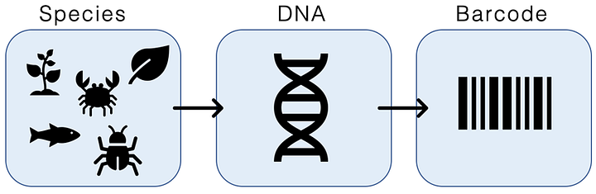
Aim
To review and highlight progress in the barcoding of South African tick species and to identify gaps in the BOLD reference library.

Slide 6
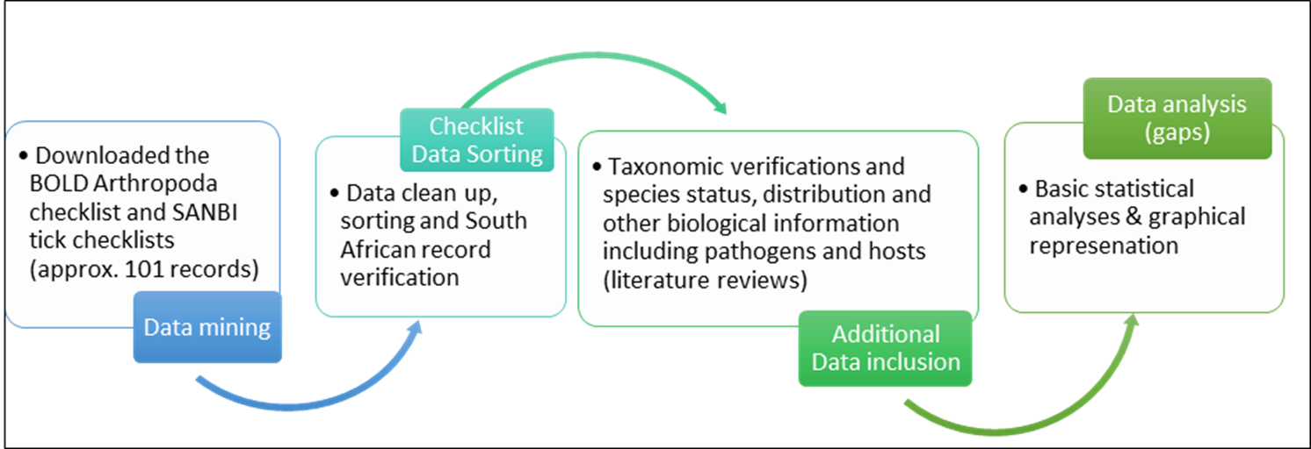
Materials and Methods
Fig 1: The number of ticks species on the South African checklist categorized according to their native status and the percentage of species barcoded per family.

Slide 7
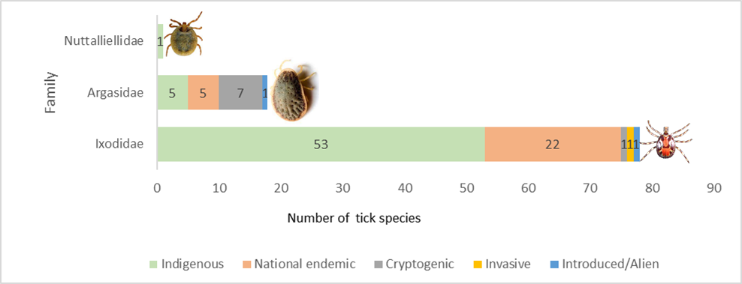
Results
Total of 97 tick species were identified.
27 endemic (National endemic), 59 regional or widespread (indigenous), One invasive, two alien.
Eight species: unverified or classified (cryptogenic).
Fig 2: The number of ticks species on the South African checklist categorized according to their native status and the percentage of species barcoded per family.

Slide 8
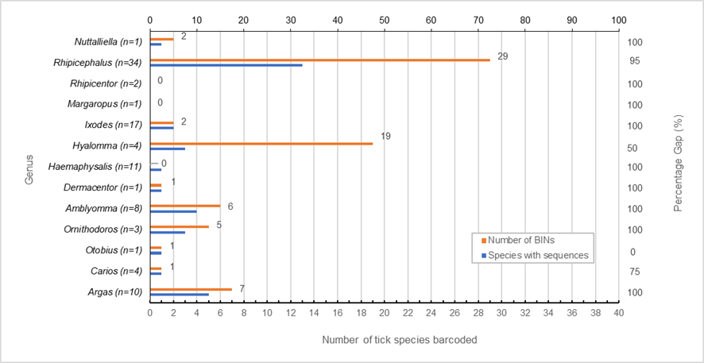
Results
31 species (32%) from 11 genera have verified DNA barcodes.
Amblyomma, Argas, Carios, Dermacentor, Haemaphysalis, Hyalomma, Ixodes, Nuttalliella, Ornithodoros, Otobius, and Rhipicephalus (Boophilus).
Margaropus and Rhipicentor had no COI barcode records on BOLD.
Fig 3: Number of BINs represented by a given number of sequences per genus also indicating number of known South African species per genus. The number within parentheses represents known species on the South African checklist.
Notes:
31 distinct tick species represented by 74 BINs, indicating high COI genetic diversity as BINs were higher than the number of species barcoded (BIN

Slide 9
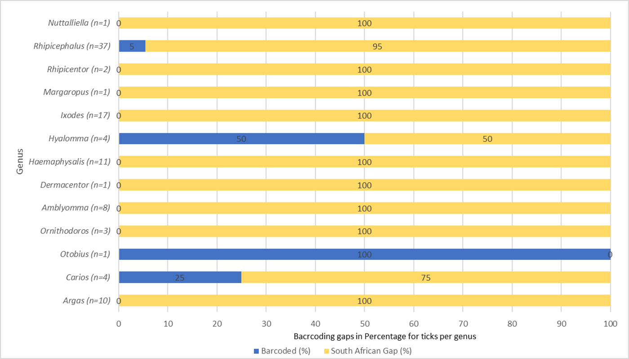
Results
Fig 4: Percentage of barcoded tick species per genera and gaps identified. The number of species per genus (n) is indicated in parentheses.

Slide 10
Results
Limited information for most tick species in the Argasidae family.
Three species: Generalists (infesting birds, reptiles, and mammals.
Three species: Bird specialists
(A. africolumbae, A. arboreus, A. walkerae).
Table 1: Host-vector relationships
Argasidae (soft ticks)
Vertebrates | Tick species
Birds (4) | Argas africolumbae (S)
 | Argas arboreus (S)
 | Argas sp. SpringbokSA
 | Argas walkerae (S)
Mammals (4) | Argas sp. SpringbokSA
 | Ornithodoros porcinus (G)
 | Ornithodoros zumpti (G)
 | Otobius megnini (G)
Reptiles (1) | Ornithodoros compactus (S)
NB: S= specialist; G= Generalist

Slide 11
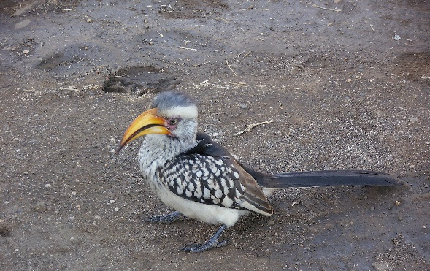
Results
Table 1: Host-vector relationships
Vertebrate | Ixodidae (hard ticks)
Birds (19) | Amblyomma hebraeum (G)
 | Amblyomma marmoreum (G)
 | Amblyomma nuttalli (G)
 | Amblyomma sylvaticum (G)
 | Amblyomma tholloni (G)
 | Haemaphysalis hoodi (G)
 | Haemaphysalis silacea (G)
 | Hyalomma rufipes (G)
 | Hyalomma glabrum (G)
 | Ixodes aulacodi (G)
 | Ixodes theilerae (G)
 | Margaropus winthemi (G)
 | Rhipicephalus appendiculatus (G)
 | Rhipicephalus (Boophilus) decoloratus (G)
 | Rhipicephalus evertsi evertsi (G)
 | Rhipicephalus gertrudae (G)
 | Rhipicephalus glabroscutatum (G)
 | Rhipicephalus nitens (G)
 | Rhipicephalus zambeziensis (G)

Slide 12
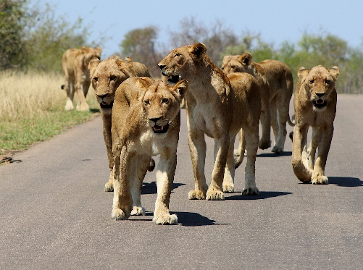
Results
Table 1: Host-vector relationships
Mammals (18) | Amblyomma hebraeum (G)
 | Amblyomma marmoreum (G)
 | Amblyomma nuttalli (G)
 | Amblyomma sylvaticum (G)
 | Amblyomma tholloni (G)
 | Haemaphysalis hoodi (G)
 | Haemaphysalis silacea (G)
 | Hyalomma rufipes (G)
 | Hyalomma glabrum (G)
 | Ixodes aulacodi (G)
 | Ixodes rhabdomysae (G)
 | Margaropus winthemi (G)
 | Rhipicephalus appendiculatus (G)
 | Rhipicephalus Boophilus decoloratus (G)
 | Rhipicephalus evertsi evertsi (G)
 | Rhipicephalus gertrudae (G)
 | Rhipicephalus glabroscutatum (G)
 | Rhipicephalus zambeziensis (G)

Slide 13
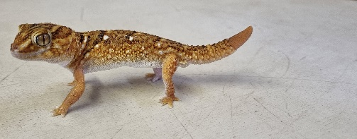
Results
Table 1: Host-vector relationships
Reptiles (7) | Amblyomma exornatum (S)
 | Amblyomma latum (S)
 | Amblyomma marmoreum (G)
 | Amblyomma nuttalli (G)
 | Amblyomma sylvaticum (G)
 | Amblyomma (Aponomma) transversale (S)
 | Ixodes transvaalensis (S)
Mammals & Reptiles | Nuttalliellidae
 | Nuttalliella namaqua (G)

Slide 14
Discussion
South Africa has a high diversity of tick species (estimated >90) (Aeschlimann, 1967).
The study reports 97 species in SA, belonging to, Argasidae, Ixodidae, and Nuttalliellidae families.
This finding contrasts previously published numbers, which estimated 106 species (80 Ixodid, 25 Argasid, and Nuttalliella namaqua) (Horak et al., 2003).
This discrepancy, can be attributed to taxonomic revisions and improved molecular identification techniques that have resulted in the reclassification of tick species.

Slide 15
Discussion
The analysis of the barcoding library revealed that species belonging to Rhipicephalus (5%) and Hyalomma (50%) genera are the most barcoded among South African species.
Species in the Rhipicephalus group: R. appendiculatus, R. microplus, R. evertsi evertsi, R. sanguineus, R. turanicus, and R. zambeziensis have been associated with disease transmission causing economic losses in the agricultural sector.
Similarly, the genus Hyalomma, has had a lot of unclear taxonomic classifications in the past that could be verified using DNA barcoding.
For instance, H. rufipes, previously listed as a subspecies of H. marginatum has since been listed as a valid species. while H. marginatum truncatum previously synonymised is now reinstated as H. glabrum (Apanaskevich & Horak 2008).
In such instances, it is ideal to incorporate molecular techniques including DNA barcoding, using multiple genes or methods to inform species delineation and taxonomic re-evaluation.

Slide 16
Discussion
Hyalomma species such as H. truncatum and H. rufipes, are important to study because they are also involved in the transmission of pathogens that are either zoonotic; Rickettsia conorii, Crimean-Congo haemorrhagic fever) or of veterinary importance (Anaplasma marginale, Babesia caballi, Theileira parva, Theileira equi).

Slide 17
Conclusion
Integrating molecular data such as DNA barcodes with ecological and epidemiological information can improve our ability to assess disease risks for control or eradication implementation plans.
This is crucial for developing targeted control strategies, mitigating disease transmission risks, and safeguarding both animal and human health.
The findings of this study emphasize the importance of prioritizing the building of DNA barcoding species reference libraries of tick species, particularly those implicated in disease transmission.

Slide 18
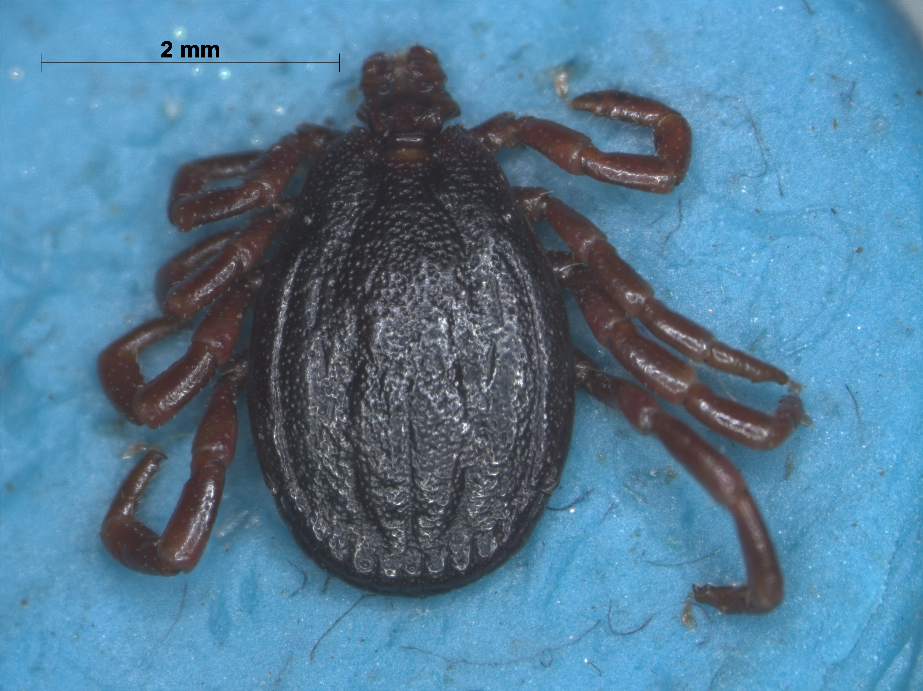
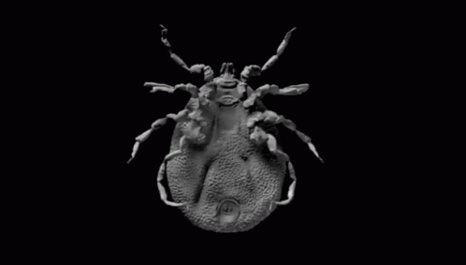
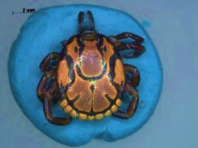
Acknowledgments
SANBI
SASVEPM Bursary
Elekanyani Mulaudzi
Email: n.Khumalo@sanbi.org.za

Slide 19
References
Aeschlimann, A., 1967. Biology and ecology of ticks (Ixodoidea) of the Ivory Coast. Acta Tropica 24, 281–405.
Apanaskevich, D., Horak, I., 2008. The genus Hyalomma. VI. Systematics of H. (Euhyalomma) truncatum and the closely related species, H. (E.) albiparmatum and H. (E.) nitidum (Acari: Ixodidae). Experimental & applied acarology 44, 115–136.
Bakkes, D.K., Chitimia-Dobler, L., Matloa, D., Oosthuysen, M., Mumcuoglu, K.Y., Mans, B.J., Matthee, C.A., 2020. Integrative taxonomy and species delimitation of Rhipicephalus turanicus (Acari: Ixodida: Ixodidae). International Journal for Parasitology 50, 577–594.
Dantas-Torres, F., 2015. Climate change, biodiversity, ticks, and tick-borne diseases: the butterfly effect. International Journal for Parasitology: parasites and wildlife 4, 452–461.
Horak, I.G., Camicas, J.-L., Keirans, J.E., 2003. The Argasidae, Ixodidae, and Nuttalliellidae (Acari: Ixodida): a world list of valid tick names. Presented at the Ticks and Tick-Borne Pathogens: Proceedings of the 4th International Conference on Ticks and Tick-Borne Pathogens The Banff Centre Banff, Alberta, Canada 21–26 July 2002, Springer, pp. 27–54.
Horak, I.G., Heyne, H., Williams, R., Gallivan, G.J., Spickett, A.M., Bezuidenhout, J.D., Estrada-Peña, A., 2018. The ixodid ticks (Acari: Ixodidae) of southern Africa. Springer.
Hornok, S., Kontschán, J., Takács, N., Heyne, H., Kovács, Á.B., Plantard, O., Keve, G., Fedorov, D., Gyuranecz, M., Halajian, A., 2023. Molecular-phylogenetic analyses of Ixodes species from South Africa suggest an African origin of bird-associated exophilic ticks (subgenus Trichotoixodes). Parasites & Vectors 16, 392.

